Slide 1
CACHE SIMULATOR
Sudeesh Naidu Yenugula (A04253575)
Bhavya Gutta(A04249172)

Slide 2
INTRODUCTION
To close the distance between the CPU and main memory and speed up data access, modern multi-processors employ a multilayer cache memory system. As a result, we must comprehend not only the architecture, but also know the internal organization of the multiprocessor. We have yet to find an educational simulator that will allow us to easily comprehend all cache parameters and their effect on program execution. We present the Cache simulator in this project, which visualizes cache hit and miss, cache line fulfilment, and the cache associativity problem for sequential and parallel algorithm execution.

Slide 3
Superscalar processor:
Superscalar processor is a representative cache implementation of a sequential architecture - For every instruction issued by a Superscalar processor, the hardware must check whether the operands interfere with the operands of any other instruction that is either • (1) already in execution, (2) been issued but waiting for completion of interfering instructions that would have been executed earlier in a sequential program, and (3) being issued concurrently but would have been executed earlier in the sequential execution of the program

Slide 4

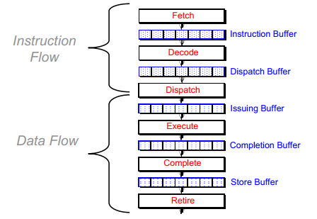
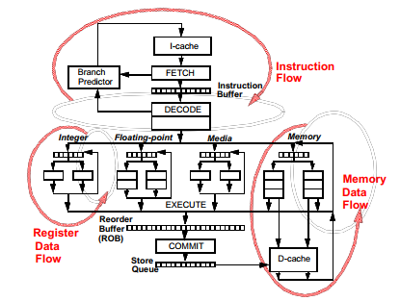
Super Scalar Pipeline Design

Slide 5
Hardware Features that support Cache
Instruction Issue Unit - Care must be taken not to issue an instruction if another instruction upon which it is dependent is not complete - Requires complex control logic in Superscalar processors - Virtually trivial control logic in VLIW processors
Parallel Execution When instructions executed in parallel, they will finish out of program order - unequal execution times specific means needed to preserve logical consistency
- Speculative Execution - Little cache typically found in basic blocks • a straight-line sequence of operations with no intervening control flow - Multiple basic blocks must be executed in parallel • Execution may continue along multiple paths before it is known which path will be executed. - Expensive in hardware

Slide 6
Cache processors - VLIW/EPIC, Superscalar Superscalar has hardware logic for extracting parallelism - Solutions for stalls etc. must be provided in hardware. Stalls play an even greater role in ILP processors. Software solutions, such as code scheduling through code movement, can lead to improved execution times. - More sophisticated techniques needed

Slide 7
Tasks
Task 1: Cache Tag Calculations
A cache has three main parameters of configuration:
Associativeness (number of ways per set)
Size of the block (size of a single block, a block is also referred to as a cache line)
Capacity or size of cache (total amount of data in the cache)
These three parameters determine the number of cache sets and methods. These parameters also specify how a reference memory address is broken down into its three components: tag, index, and offset.
Number of bits in the address
Number of cache sets
Total cache line number in the cache
Index bits number in the address
Amount of tag bits at the address
Task 2: Calculation generalisation
Apply formula for calculating the following quantities in terms of A, B and C. The formulas log(A), log(B) and log(C) may be more straightforward than A, B, and C. We assumed A, B and C to be all powers of 2. Write the following formulas:
Number of bits in the address
Number of cache sets
Total cache line number in the cache
Index bits number in the address
Amount of tag bits at the address

Slide 8
Task 3: Cache initialization
Now we have applied Task 2 formulas to finalise in cache.c 5 lines of make cache. The variables for n offset bit, n set, n total cache line, n index bit, and n tag bit must be specified.
Notice that there is a log2 function in the <math.h> library included.
Since the actual data values are not manipulated (like a real processor), we only calculate the hit/miss for each memory reference, so there is no need to store cache data values (actually trace values are not even given).
A two-dimensional assortment of tags can depict the cache. (The second dimension is only relevant when the cache's associativity is greater than 1.) Finish the make cache function by creating the array of tags to determine if a cache hit or miss has occurred. The help function is required in make 2d matrix. It allocates an array with each object holding a pointer to another malfunction array in order to create a n row matrix with n col elements of size.
To stop using a valid bit, all tag values are initialised to zero; all the blocks are assumed to be valid and valid in the simulation. (We can simplify this because the trace we use does not have any addresses in the address range which create an all-zero tag for the caches we mimic.)

Slide 9
Task 4: Address Bits Extraction
Coding your cache.c by using three different methods to extract tag bits, index bits and block address from any given address. The name of the process is as follows:
get cache day ()
get-cookie index ()
get cache block addr(): the original offset bit address zeroed.
It is very important that the integer values are not converted into strings (which is slow and unnecessarily verbose). Integer bit manipulation instructions (shifts, bitwise or not, etc.) can be used to carry out such bit extraction operations easily and effectively. You can use ~0 to generate an integer value with all bits (bit-wise not of zero). Similarly, it may be useful to move the address in both directions. Completion of the method of access
Finally, enter the access cache method that performs cache searches for every load or store; it returns true if the access is a hit, false when the access results in a defect.

Slide 10
Task 5: A direct mapped cache for exploring Hit Rate versus Capacity
Finalize the direct cache access method. A direct-mapped cache parameterized by B and C can now be simulated by the simulator.
Task 6: Implementing Set Associativity to explore Hit Rate vs. Associativity
First, We make a copy of the operating cache. Run a cache direct mapped.c command to copy cache.c to a new cache direct mapped.c file. This means you will get partial credit if the latest updates break down the installation of the direct-mapped-cache.
Now we change the simulator to allow n-way caches. Each set in the cache requires an array of "tag" (one for each way) and a single "LRU" bit used to overwrite the cache.
Generate misrate data with the same block size and caches, but simulate two-way caches. The outcome is the initial data obtained for a direct cache (two lines on the graph: one for direct-mapped caches and one for the 2-way set-associative cache).

Slide 11
Task 7: Pass to Explorer bytes Write-Back vs Write-Through Caches
Traffic to a cache can be computed easily: it is the amount of misses compounded by the block size so the whole memory block must be placed into the cache on each miss. The cache traffic is writing traffic, depending on whether the cache is write-back or type-through. In a simulation, the simulator will measure traffic for both writing and encoding caches as follows:
Write-through: The average number of bytes written in each store, compounded by the numbers in the stores, is the write-through buffer. The track does not define how many bytes per store writes, but suggests that each store writes 4 bytes in calculations.
Write-back: Traffic is the amount of dirty evictions multiplied by block sizes for the write-back cache method. Because at most one eviction occurs per miss, the retrieval traffic will at most double the total traffic (in the case in which all evicted blocks were dirty). Modify the simulator by inserting a "dirty" bit for each block in cache in order to measure the amount of dirty expellations. Whenever a store operation writes to the block, set the dirty bit. It's not a dirty bit by word or byte; it's a dirty bit for the whole cache line.
In cache stats.c, compute and store cumulative traffic for both total bytes transferred write back and total bytes transferred write through variables.
A written distribution policy is used for all instances. This means that the number of misses for the writing and writing caches is the same, only the traffic differs.
A graph is generated for a two-way set-associative cache with 64-byte blocks.
Plot two lines: (1) the write-through cache (miss fill traffic + write-through traffic), and (2) the write-back cache.

Slide 12
Task 8: Hit rate vs. size of block
The effect of various block sizes of the cache. With the aid of the 32KB emulator, a dual-way, rewrite cache of various block sizes can be calculated: 8B, 16B, 32B, 64B, 128B, 256B and 512B blocks. We create from this data two graphs:
Miss rate graph. Miss rate graph. We track the data on the y-axis graph, the cache block size log, and the miss rate drawn as a line.
Graph of traffic. We graph the data into the entire y-axis write-back traffic, the x-axis cache block size log and the overall write-back traffic as the rows.

Slide 13
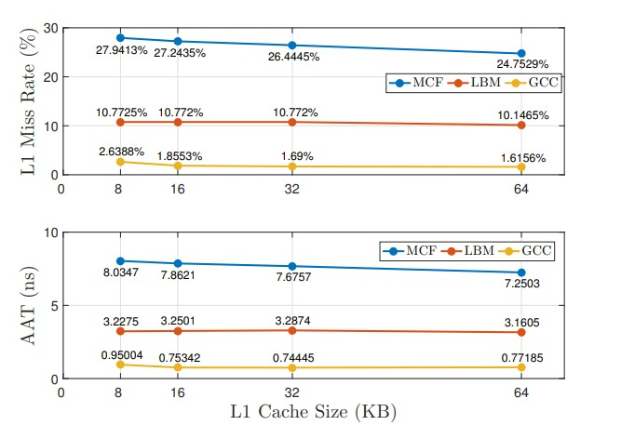
EXPLORING THE L1 CACHE DESIGN
Figure 1.1: L1 cache miss rate, Average Access Time(AAT) and L1 cache size, when L1 associativity is 4

Slide 14
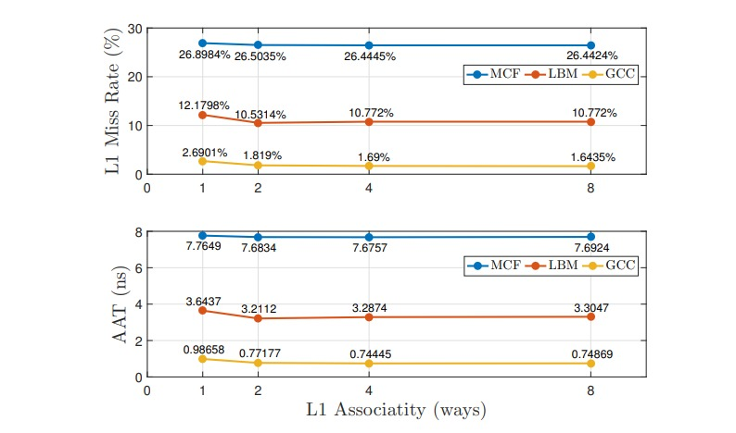
1.2 PLOT 2
Figure 1.3: L1 cache miss rate, Average Access Time(AAT) and L1 cache associativity, when L1 cache size is 32KB
r fff432

Slide 15
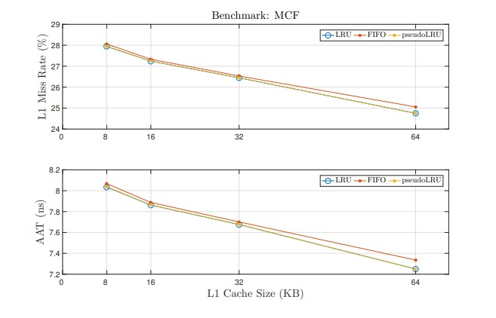
EXPLORING THE REPLACEMENT POLICY
Figure 2.1: L1 cache miss rate, AAT and L1 cache size as well as replacement policy when L1 cache associativity is 4

Slide 16
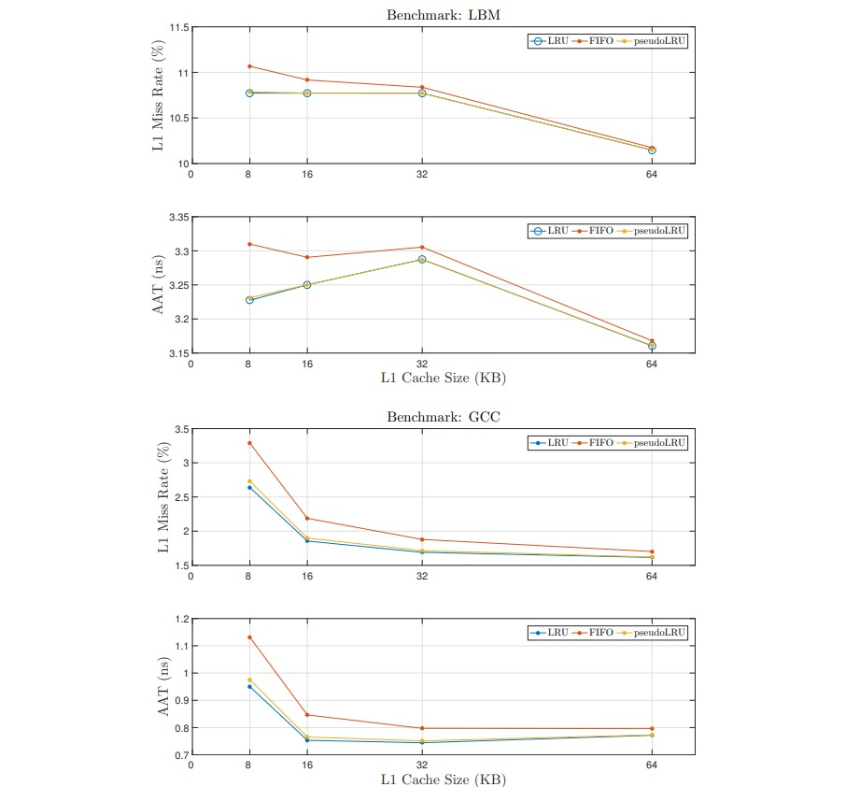
Figure 2.2: L1 cache miss rate, AAT and L1 cache size as well as replacement policy when L1 cache associativity is 4

Slide 17
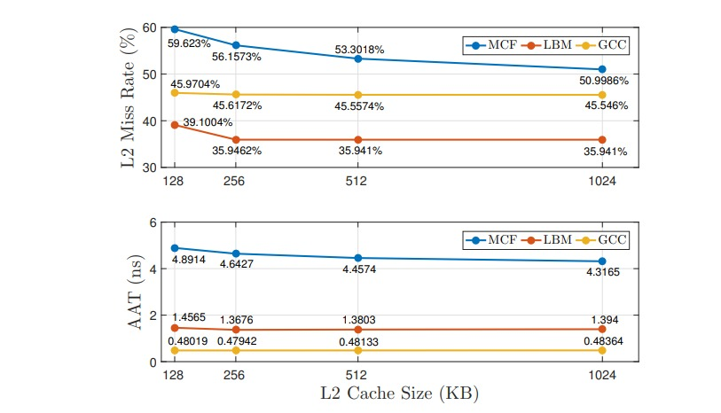
EXPLORING THE L2 CACHE DESIGN
Figure 3.1: L2 cache miss rate, Average Access Time(AAT) and
L2 cache size, when L1 cache size is 16KB, L1 associativity is 4, L2 associativity is 8

Slide 18
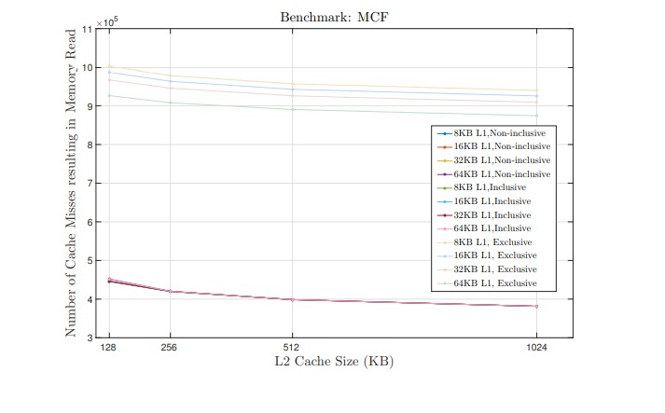
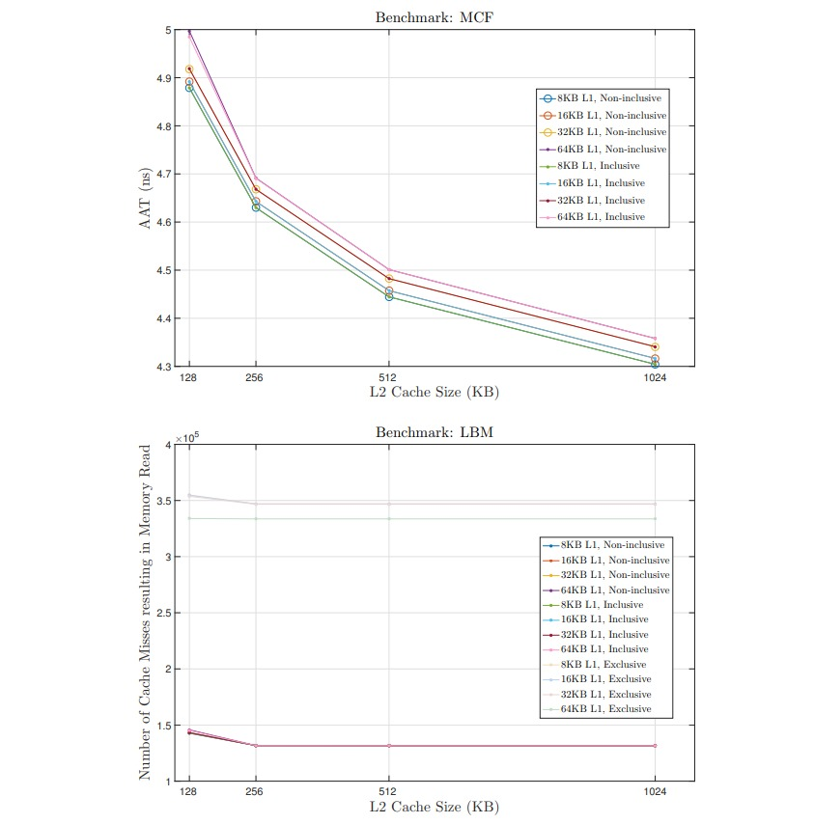
EXPLORING THE INCLUSION PROPERTY CHOICES

Slide 19
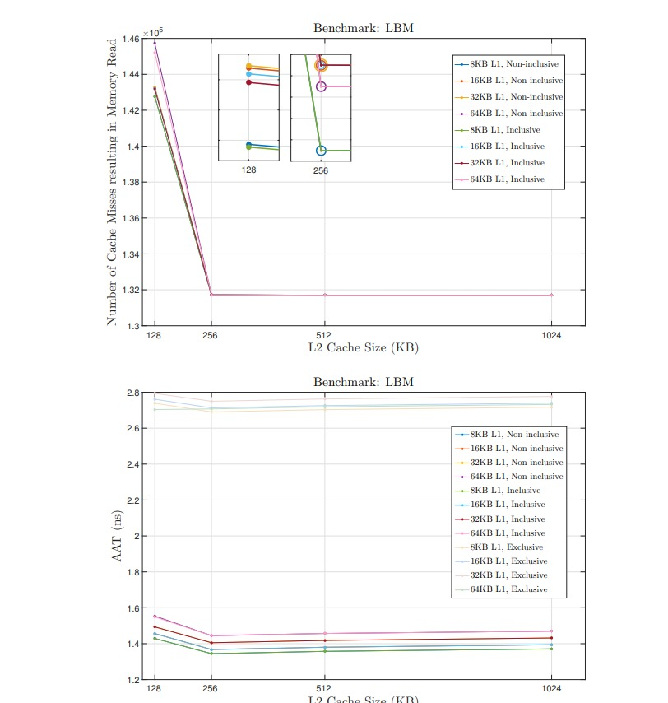
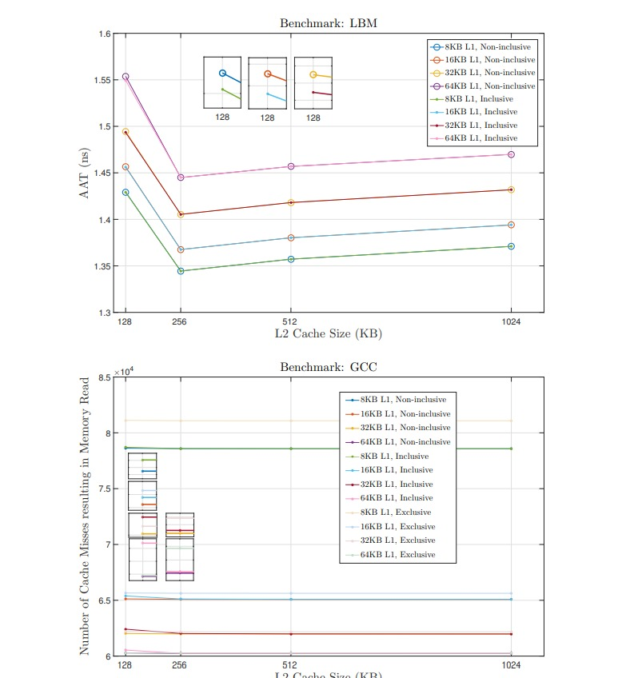

Slide 20
